Slide 1

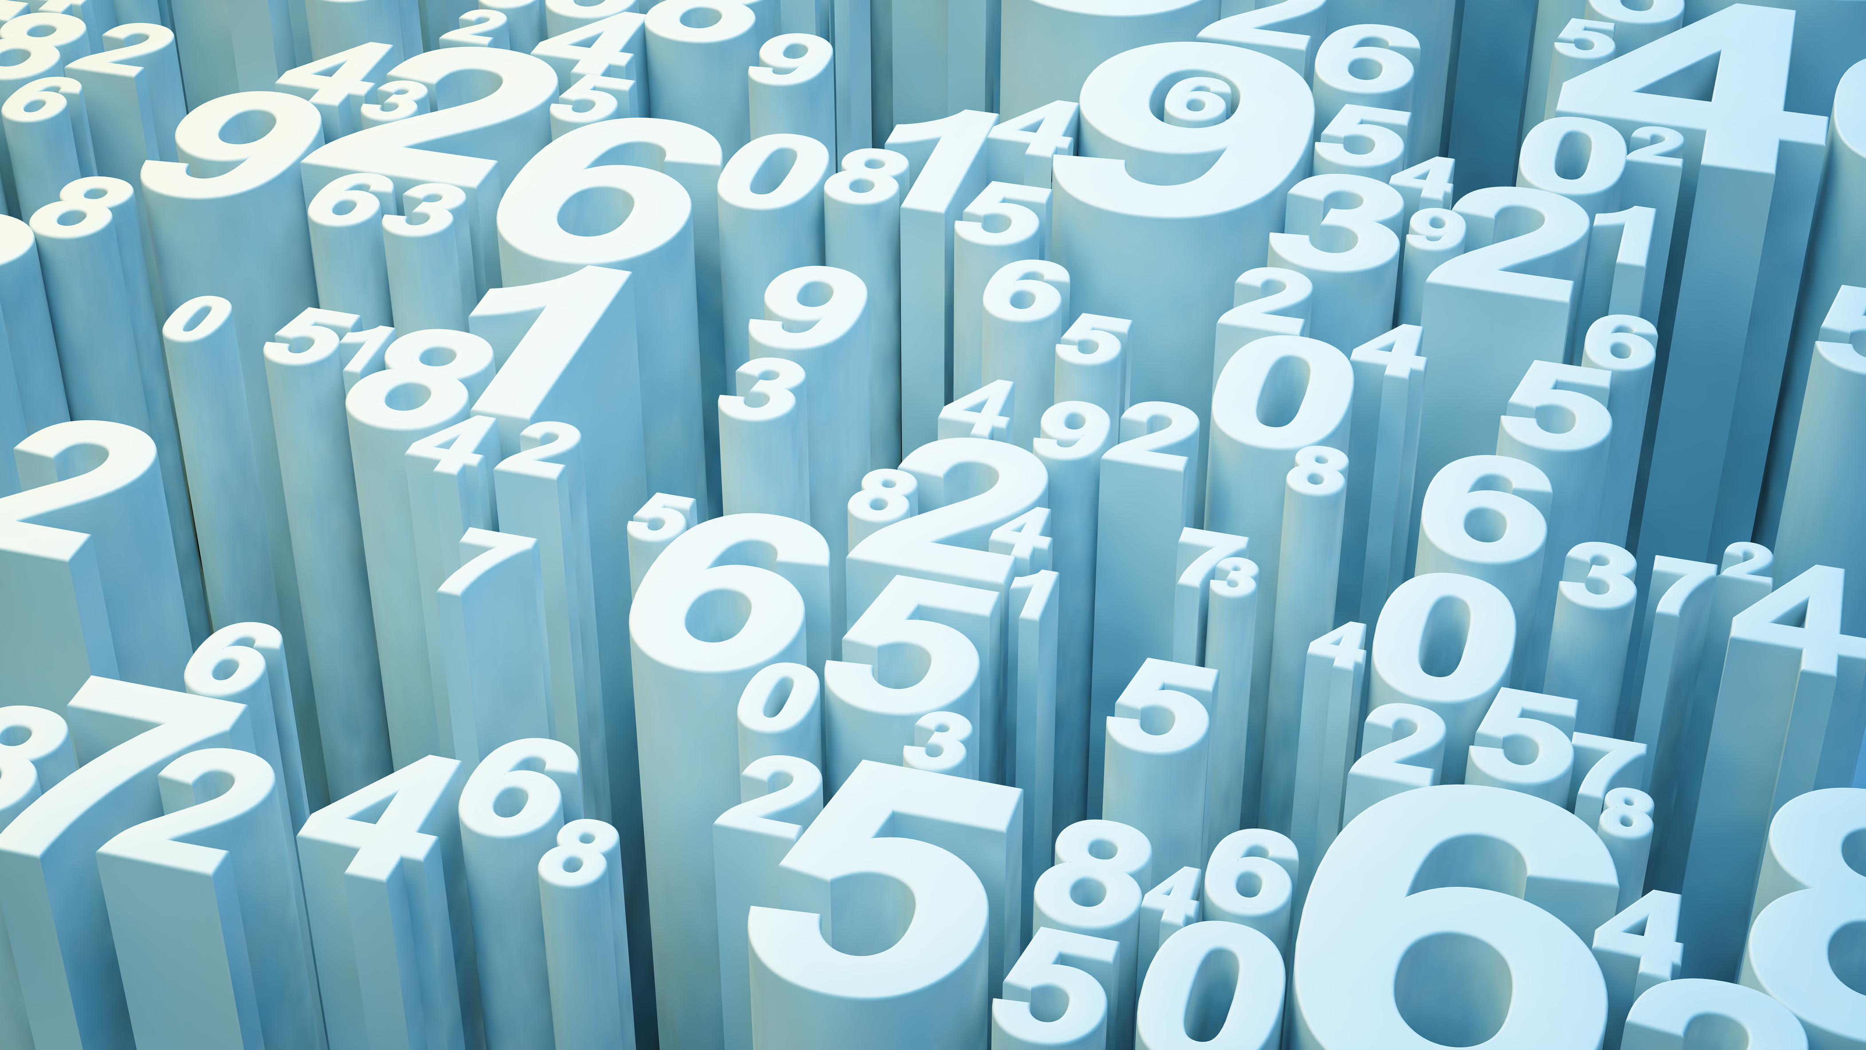
Project 2 DATA WRANGLING
Presented By
Priyanka Verma

Slide 2

What is Data Wrangling?
Technical Skills:
1. Data Acquisition
2. Data Wrangling

Slide 3
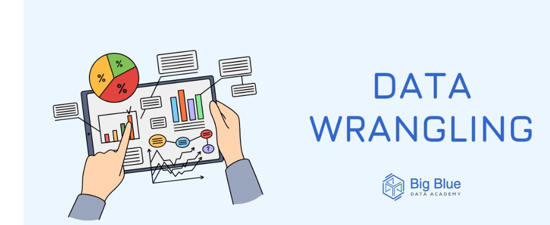
What do you understand by data wrangling?
Data wrangling– also called data cleaning , data remediation , or data munging—refers to a variety of processes designed to transform raw data into more used formats .The exact method differ from project to depending on the data your ‘re leveraging and the goal you ‘re trying to achieve.

Slide 4
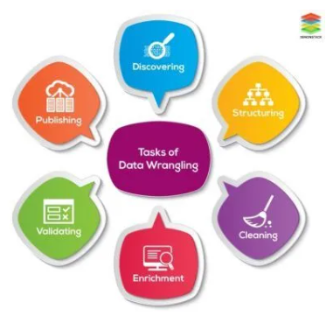

Slide 5
Steps in Data Wrangling
Discovery
Discovery refers to the process of familiarizing yourself with data so we can conceptualize how we might use it .We can liken to looking in our refrigerator before cooking a meal to see what ingredients we have at our disposal.
During this step we identify trends or patterns in data, along with obvious issues, such as missing or incomplete values that need to be addressed. This is an important step ,as it will inform every activity that comes afterward.
Each data project requires a unique approach to ensure its final dataset is reliable and accessible .That being said several processes typically inform the approach These are commonly referred to as data wrangling steps or activities.

Slide 6
(2) Structuring
Raw data is typically unusable in its raw state because it’s either incomplete or misormatted for its intended application .Data structuring is the process of taking raw data and transforming it to be more readily leveraged .The form of our data takes will depend on the analytical model we use to interpret it .

Slide 7
(3) Cleaning
Data cleaning is the process of removing inherent errors in data that might distort your analysis or render it less valuable .Cleaning can come in different forms, including deleting empty cells or rows ,removing outliers, and standardizing inputs. The goals of data cleaning is to ensure there are no errors (or as few possible )that could influence your final analysis.

Slide 8
(4) Enriching
Once we understand our existing data and have transformed it into a more usable state ,we must determine whether you have all of the data necessary for the project at hand .if not ,you may choose to enrich or augment your data by incorporating values from other datasets .For this reason ,its important to understand what data is available for use.
If we decide that enrichment is necessary ,we need to repeat the steps above for any new data .

Slide 9
(5) Validating
Data validation refers to the process of verifying that your data is both consistent and of a high enough quality .During validation , we may discover issues we need to resolve or conclude that our data is ready to be analyzed. Validation is typically achieved through various automated processes and requires programming.

Slide 10
(6) Publishing
Once our data is validated , we can publish it .This involves making it available to others within our organization for analysis. The format we use to share the information – such as a written report or electronic file – will depend on our data and the organization ‘s goals.

Slide 11
The Importance Of Data Wrangling
Any analyses a business perform will ultimately be constrained by the data that informs them if data is incomplete ,unreliable ,or faulty ,then analyses will be too diminishing the value of any insights gleaned.
Data wrangling seeks to remove that by ensuring data is in are liable state before it’s analyzed and leveraged .This makes it a critical part of the analytical process

Slide 12
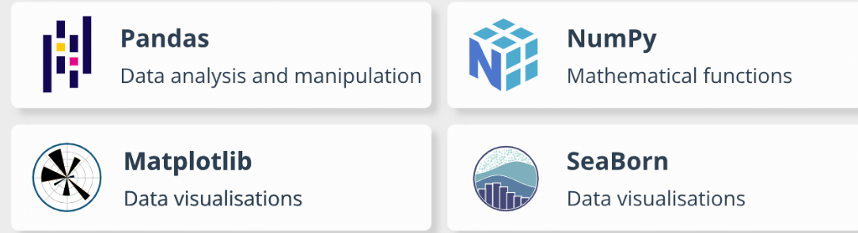

Libraries that I use for data wrangling

Slide 13


